Slide 1

Enterprise Network Infrastructure & VPN Solutions (HQ & Branch)
Team Members :
Ahd Assem Elgohary (21067349)
Kholoud Ahmed EL-Sokkary (21027261)
Nada Wesam Alhlwany (21029590)
Malak Khaled Hamdy (21092572)
Reem Ayman Abdelaziz (21056379)
Aya Allah Anwar Hamdoun (21083747)

Slide 2

Project Overview & Objectives
Project Definition:
This project aims to design and implement a secure enterprise network infrastructure connecting a Headquarters (HQ) and a Branch Office using GNS3 Simulator.
The infrastructure integrates Cisco Switching for Layer 2 security, FortiGate Firewalls for Layer 3 protection, and Windows Server 2022 for centralized management.
Key Objectives:
Connectivity: Establish reliable communication between sites using SD-WAN & IPsec technology.
Security: Implement Port Security, MAC Filtering, Firewall Policies and Security Profiles to protect against unauthorized access .
Remote Access: Enable secure remote work capabilities using SSL VPN.
Management: Centralize user control via Active Directory and Group Policies.

Slide 3
What is VPN? (Concept & Importance)
Definition:
VPN (Virtual Private Network) is a technology that allows two remote networks to communicate securely over the public internet by creating an encrypted tunnel.
Types Of VPN
Security Pillars:
Confidentiality: Data is encrypted.
Integrity: Ensures data is not altered.
Authentication: Verifies the identity of communicating parties
By Usage
1) Remote Access VPN
2) Site-to-Site VPN
By Deployment Method
1) Client-Based VPN
2) SSL VPN (via browser)
3) IPsec VPN (Site-to-Site)
By Protocol Type
1) PPTP — Point-to-Point Tunneling Protocol
2) L2TP/IPsec — Layer 2 Tunneling Protocol
3) OpenVPN
4) IKEv2/IPsec
5) WireGuard

Slide 4
Project Roadmap (Timeline)
Network Foundation: VLAN Segmentation & Layer 2 Security.
Week 1: SSL VPN Concepts & Configuration.
Week 2: IPsec VPN Configuration (Site-to-Site).
Week 3: FortiGate VPN with SD-WAN Optimization.
Windows Server Administration: Active Directory & GPO.
Conclusion & Final Report.

Slide 5
Network Topology & Segmentation (Foundation)
Infrastructure:
Two sites (HQ & Branch) connected via dual WAN routers for redundancy.
VLAN Configuration (Departmental Segmentation):
VLAN 10 (IT): Technical staff devices.
VLAN 20 (HR): HR users and recruitment systems.
VLAN 30 (Finance): Secured financial transactions (High Security).
VLAN 40 (Sales): Sales team and CRM tools.
VLAN 50 (Management): Executive management devices.
VLAN 60 (Servers): Internal servers network.
Switch Configuration (Trunk Link):
switchport mode trunk
switchport trunk allowed vlan 10,20,30,40,50,60 (Allows all VLAN traffic to pass to the FortiGate firewall).

Slide 6
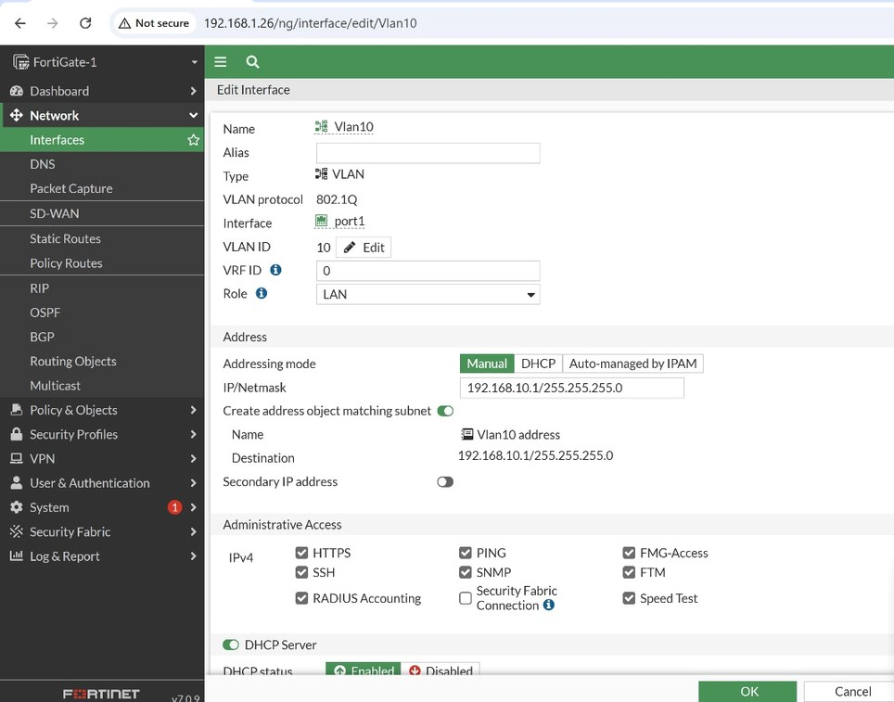
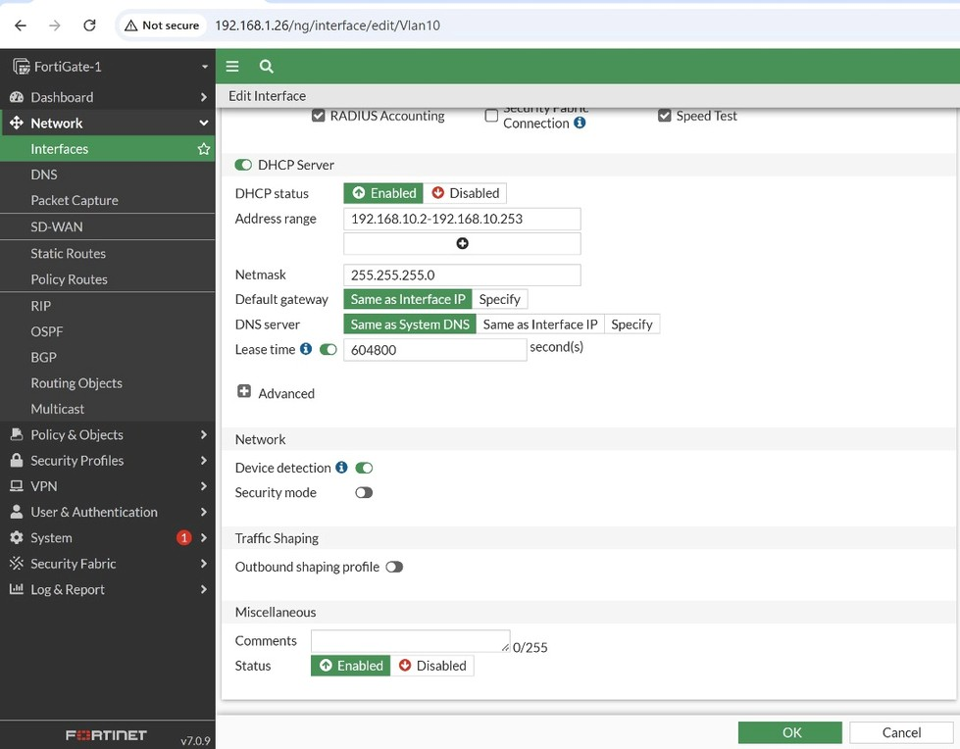
Cont. Network Topology & Segmentation (DHCP From Fortigate)

Slide 7
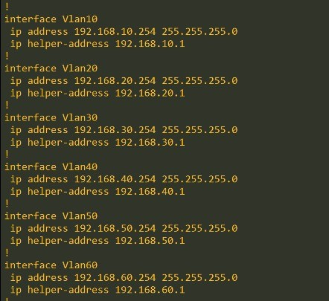
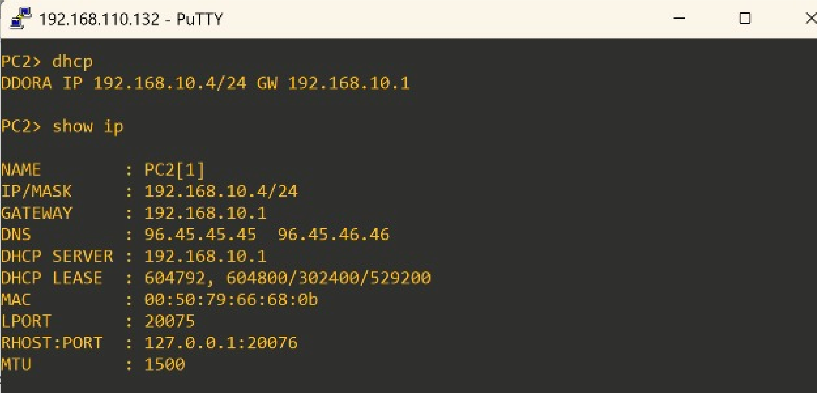
Cont. Network Topology & Segmentation (Helper Address For DHCP & Test)

Slide 8
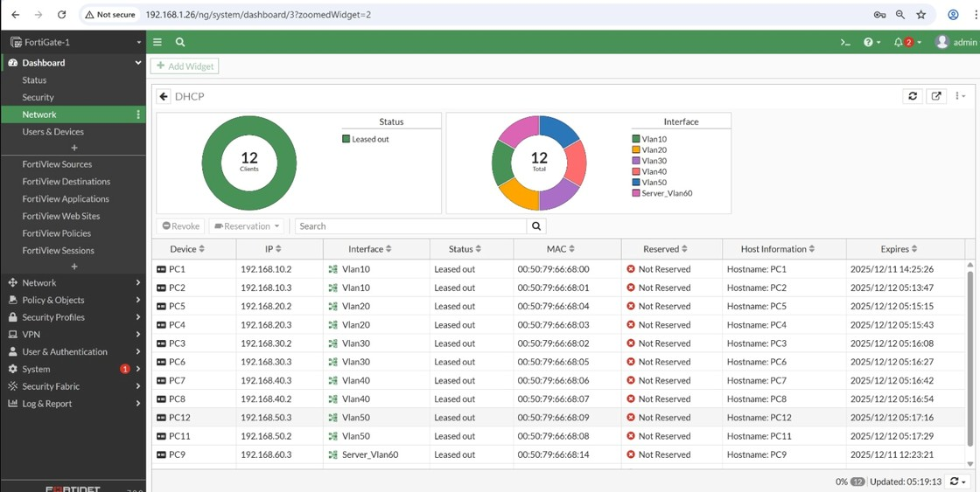
Cont. Network Topology & Segmentation (Fortigate DHCP Client)

Slide 9
Layer 2 Security (Port Security)
Objective:
Prevent unauthorized devices from accessing the network and block MAC Spoofing attacks.
Configuration (Access Switch):
switchport mode access
switchport port-security
switchport port-security maximum 1 (Limits access to only one device per port).
switchport port-security mac-address sticky (Dynamically learns and saves the legitimate MAC address).
switchport port-security violation shutdown (Port shuts down immediately if a violation occurs).
Result: The switch successfully detected an unauthorized Kali Linux device and disabled the port.

Slide 10
Advanced Security (MAC Filtering)
Strict MAC filtering applied on Finance VLAN (30).
Policy: Deny_Unknown_Finance_MACS blocks any device not explicitly listed in the allowed address objects, ensuring zero-trust access for the financial subnet.
Note on Log Evidence (FortiGate)The FortiGate log evidence for denied MAC traffic was not generated, because Port Security on the access switch blocked the unauthorized device locally before its traffic could reach the firewall. As a result, no packets from the attacker were forwarded to the FortiGate, and therefore no deny logs were created at the firewall level.

Slide 11
Layer 3 Security (Firewall Policies & Profiles)
Firewall Policies: Created 6 separate internet access policies for each VLAN (IT-HR-Finance-Sales-Management-Servers) To the Internet
Web Filtering Profiles (Productivity & Security):
IT: Allow Microsoft, Block Facebook.
HR: Allow Zoom, Block Reddit.
Finance: Allow Investopedia, Block TikTok.
Sales: Allow Shopify, Block YouTube.
Management: Allow LinkedIn — Block Facebook
Servers: Allow GitHub — Block TikTok

Slide 12
Cont. Layer 3 Security (Firewall Policies & Profiles)
Antivirus Settings:
Enabled all protocols: HTTP, HTTPS, FTP, IMAP, POP3, SMTP
Enabled include mobile malware protection
Enabled quarantine
Application Control:
Applied Allow & Block Actions for specific applications per VLAN needs
Added Application Filters to block unnecessary applications

Slide 13
SSL VPN (Remote Access)
Objective:
Allow secure remote access for admins to manage the network.
Configuration Details:
Portal Mode: Tunnel Mode.
Split Tunneling:
Enabled (Traffic is restricted only to VLAN 50 Management subnet for security).
User Group: SSL_VPN_USERS.
Custom Port: 10443 (Configured to avoid conflicts with standard HTTPS services).
Access Policy: Firewall policy allows traffic from ssl.root interface to VLAN 50 only.

Slide 14
IPsec VPN (Site-to-Site)
IPsec (Internet Protocol Security)
Is a set of protocols (IKE, ESP, AH) used to make two remote sites ( two LAN networks) communicate as if they are on the same local network over the internet by creating an encrypted tunnel between them.
Why use IPsec?
Connect company branches together (Site-to-Site)
Allow remote users to securely access the corporate network (Remote Access)
Protect sensitive data in transit, such as financial or medical information
Secure traffic traveling over the public Internet

Slide 15
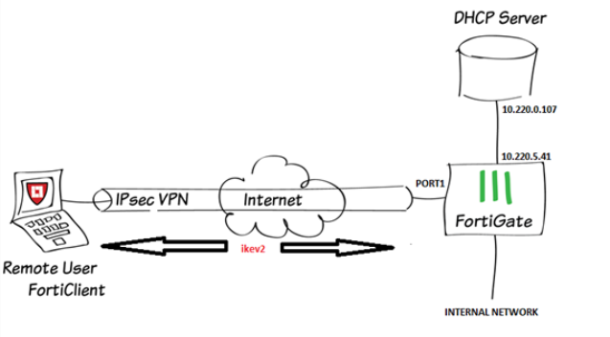
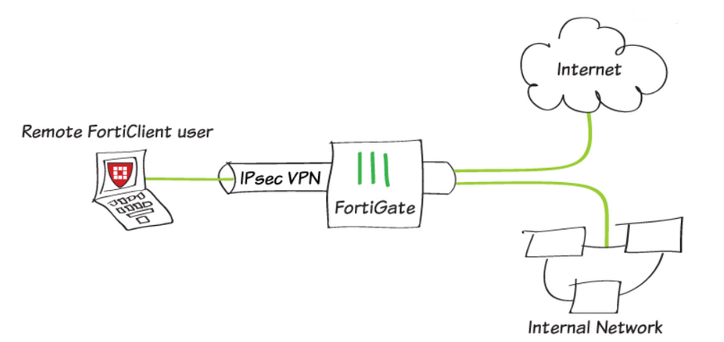
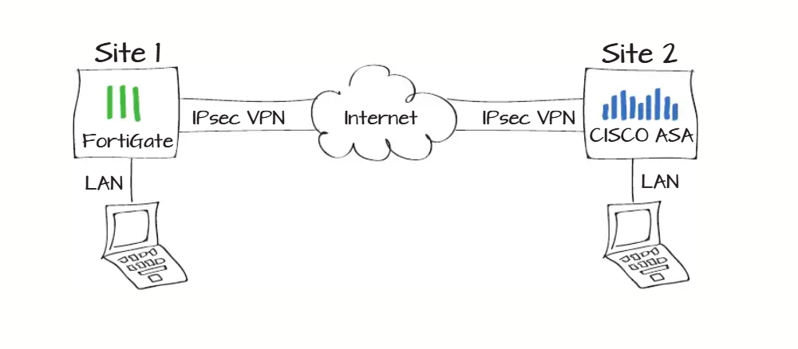
IPSEC VPN Types
Site-to-Site VPN
Dial-Up / Dynamic VPN
Remote-Access IPsec VPN

Slide 16
Cont. IPsec VPN (Site-to-Site)
Scenario: Establishing an encrypted tunnel between HQ (192.168.x.x) and Branch (172.16.x.x).
Protocol Suite & Phase Settings:
Phase 1 (IKE): Authenticates devices using Pre-Shared Key (PSK) and negotiates security associations.
Phase 2 (ESP): Encrypts the actual data traffic.
Security Algorithms:
Encryption: AES-256 (Strong encryption standard).
Integrity: HMAC-SHA256 (Ensures data is not tampered with).
PFS: Perfect Forward Secrecy enabled for key independence.

Slide 17
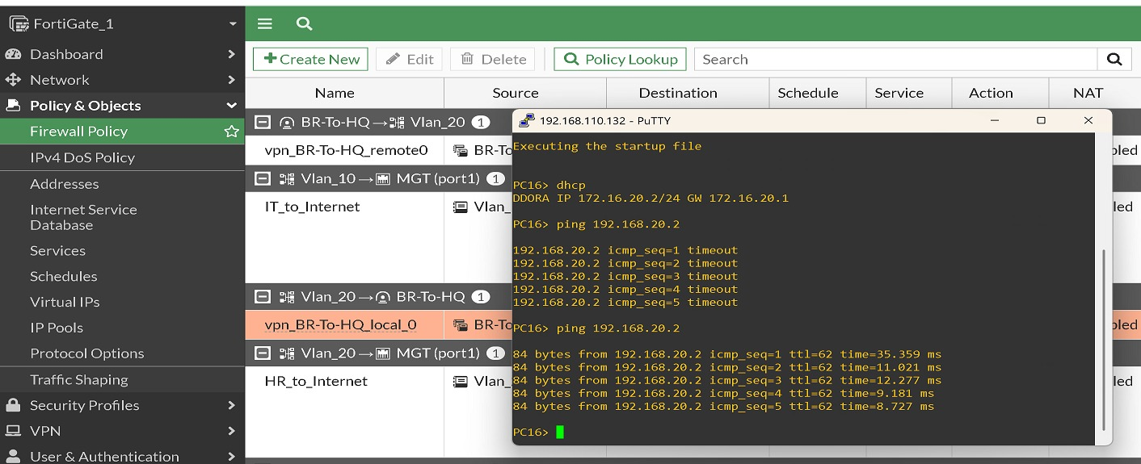
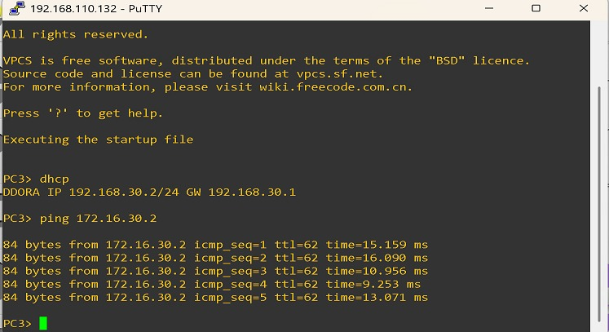
Cont. IPsec VPN (Site-to-Site)

Slide 18
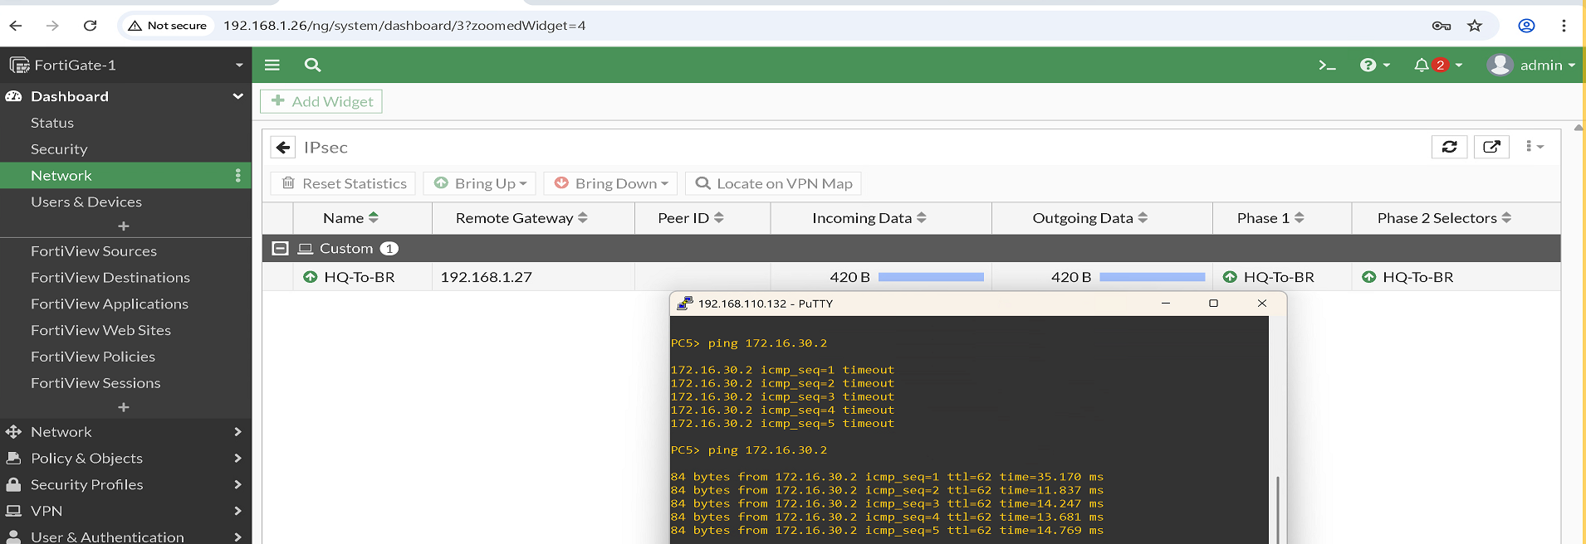
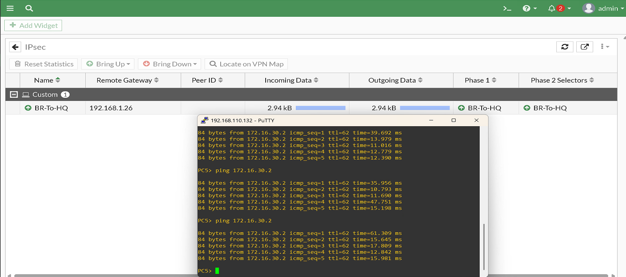
Cont. IPsec VPN (Site-to-Site)

Slide 19
SD-WAN Configuration
Setup: Configured SD-WAN Zones with dual WAN members: WAN_R1 (Gw: 10.10.10.1) and WAN_R2 (Gw: 10.20.20.1).
Performance SLA (Health Check):
Targets: 10.10.10.1 and 10.20.20.1.
Thresholds: Latency 50ms, Jitter 20ms, Packet Loss 5%.
Traffic Steering Rule:
Strategy: Best Quality. Traffic is automatically routed to the interface with the lowest latency/packet loss.
Failover Test:
Action: Manually disabled WAN_R1.
Result: Traffic seamlessly failed over to WAN_R2 with Zero Packet Loss and no user disruption.

Slide 20
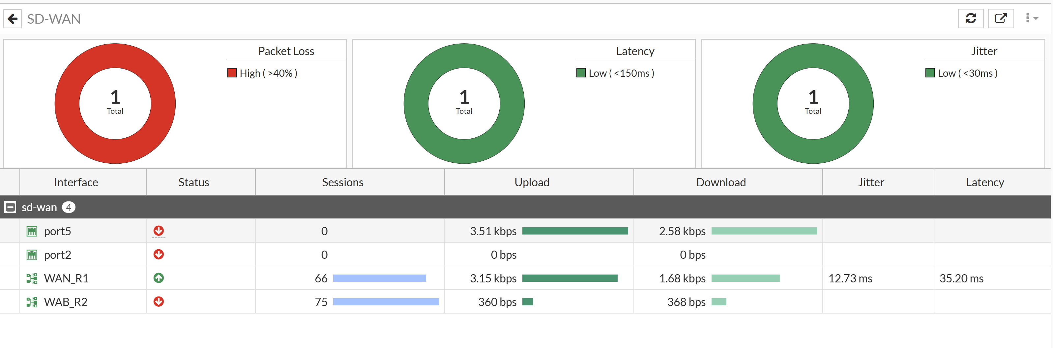
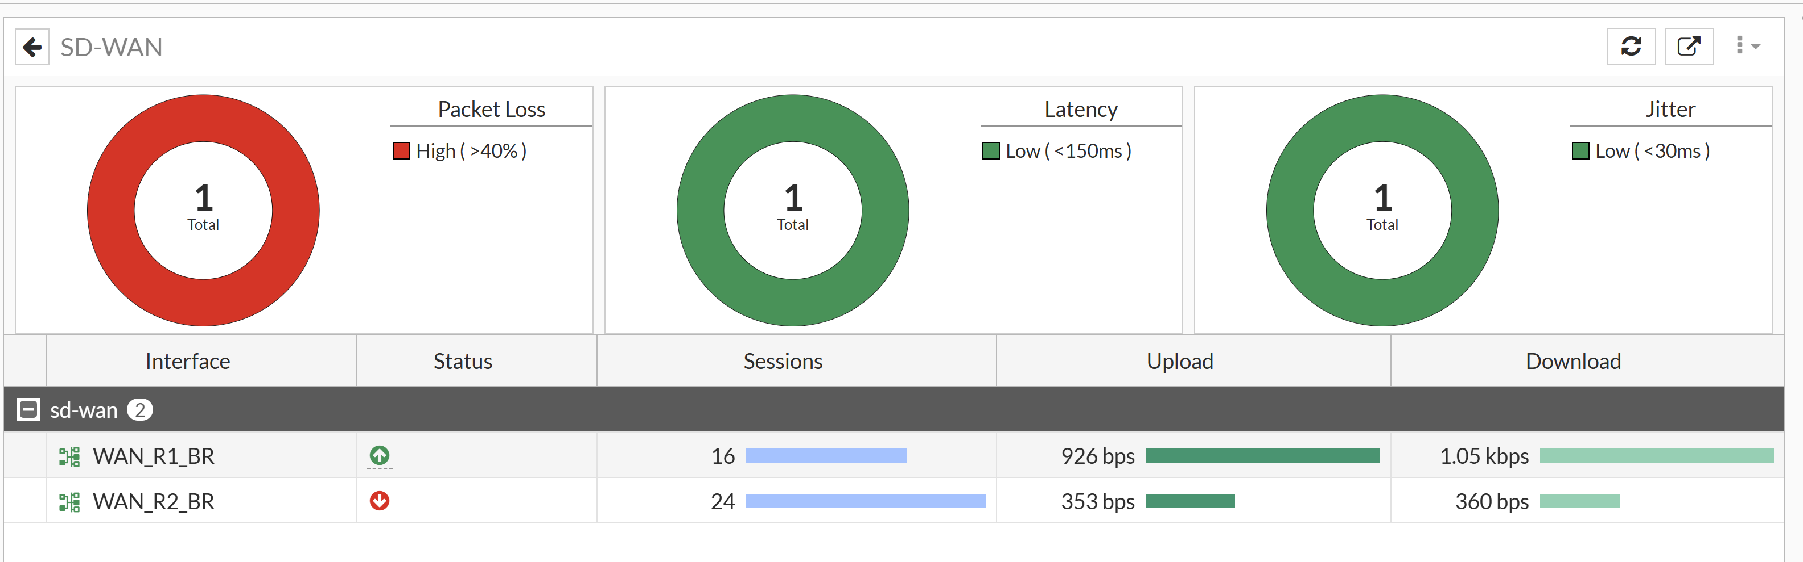
Cont. SD-WAN Configuration

Slide 21
Windows Server Administration
Domain Controller:
Hostname: WIN-CH5K1CJCC4R.
Domain: company.local.
IP Address: 192.168.60.10 (Located in the secure Server VLAN 60).
User Management:
Centralized users created and organized into Organizational Units (OUs) matching the VLAN structure (IT, HR, Sales, etc.).
Group Policy (GPO):
Deployed Sales-Mapped-Drives GPO to automatically map shared network folders for authorized users upon login.

Slide 22
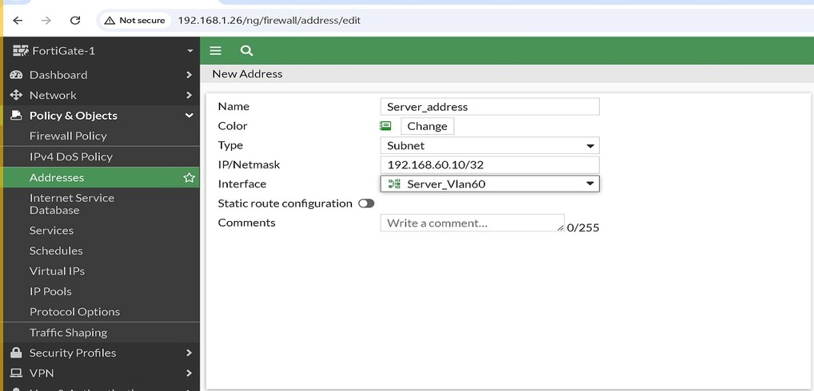
Cont. Windows Server Administration (Assign IP for server in its Vlan )

Slide 23
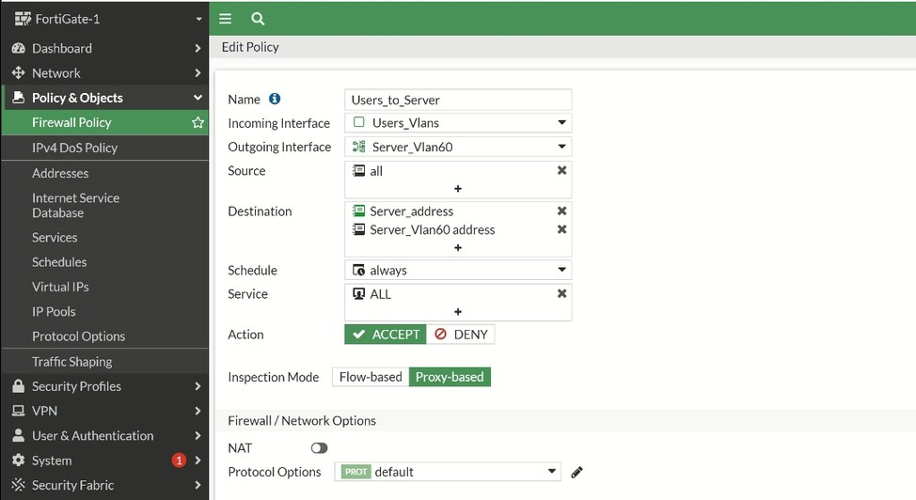
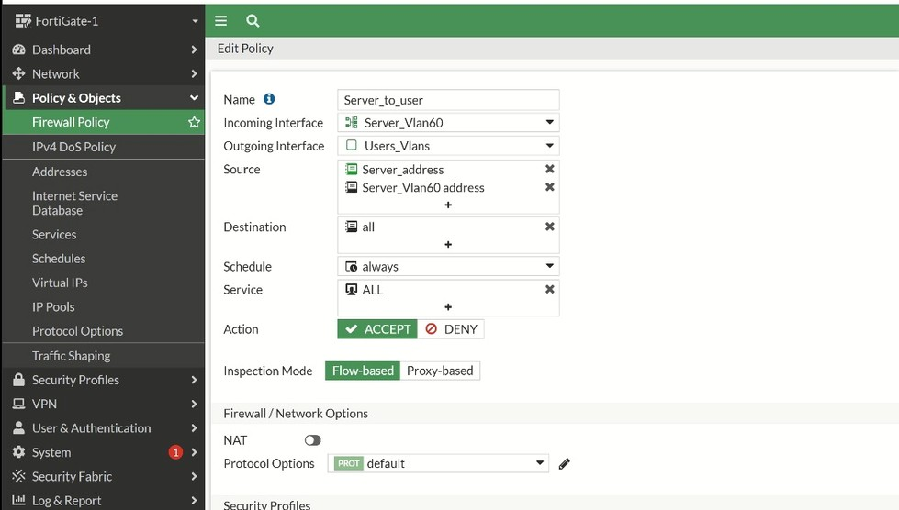
Cont. Windows Server Administration (Creating Firewall Policy)

Slide 24
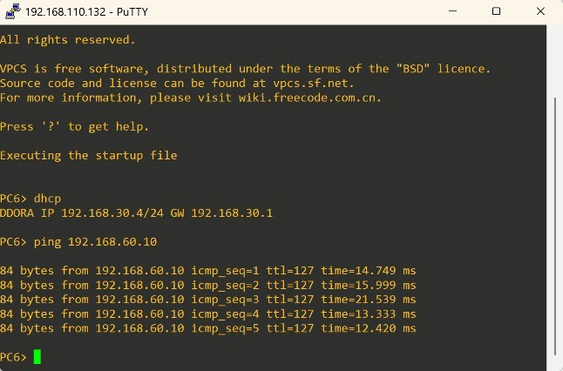
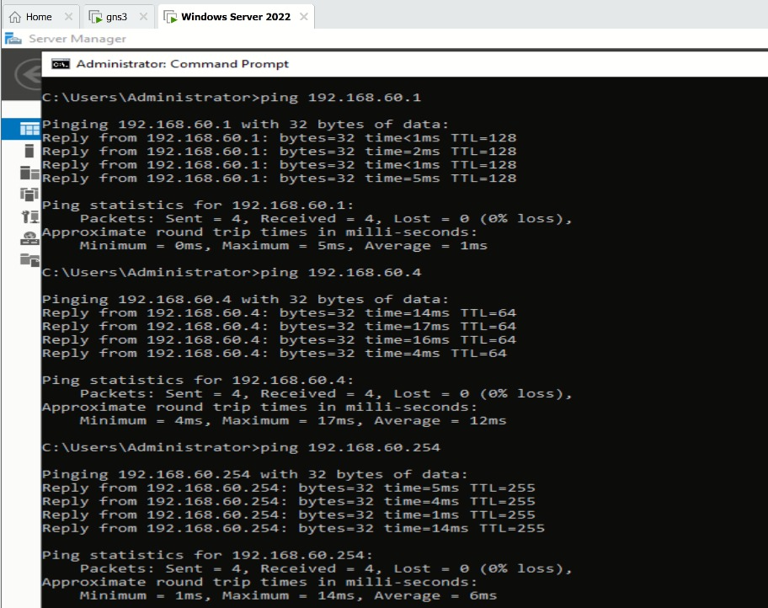
Cont. Windows Server Administration (Testing)

